Slide 1
Titanic Survival Prediction
Doudou Shi,Yue Shang

Slide 2
library(tidyverse) library(tidymodels) library(VIM) library(rsample) library(vip) library(yardstick)

Slide 3
Agenda
Introduction
Questions
Date Preparation
Exploratory analysis
Modeling Prediction
Summary/Conclusion

Slide 4
1. Introduction
The Tragic Titanic
The Titanic is one of the most famous cruise ships of the 20th century, not only because it was built to be the largest luxury cruise ship in the world in that century, but also because it collided with an iceberg on its first voyage, which eventually led to the sinking of the entire ship. Almost half of the passengers on board lost their lives as a result.

Slide 5
2. Questions
Q1: Which variable has the greatest impact on survival rate?
Q2: In each variable, which stage/part has a higher survival rate?
Q3: Which model can predict the survival rate more accurately?

Slide 6
3. Data Preparation

Slide 7
Processing NA values
View which variables have missing values ## Missings in variables: ## Variable Count ## Survived 418 ## Age 263 ## Fare 1 ## Cabin 1014 ## Embarked 2
Fare: The median Fare of passengers who meet the two conditions of Pclass=3 and Embarked=="S“
Embarked: When Embarked=c, their Fare’s values are the most similar. Thus Replace NA with C at here
Age: Creating a linear regression equation to predict the missing age values.
Cabin: Here the data is missing nearly 70%. Therefor I do not use this variable data.

Slide 8
Extract each person’s title
## Master Miss Mr Mrs Officer ## female 0 264 0 198 4 ## male 61 0 757 0 25
"Officer"#People with higher status or higher education
Remove useless col
PassengerId, Name, Cabin, Ticket

Slide 9
4. Exploratory analysis

Slide 10
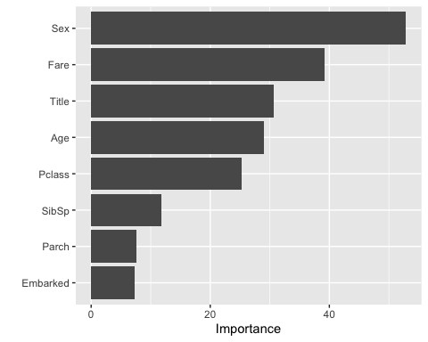
a. Random forest

Slide 11
- According to the random forest, we can see that “gender” has the greatest impact on survival, and the least impact is “Embarked”, where people board the boat.

Slide 12
b . Different variables v.s survival rates

Slide 13
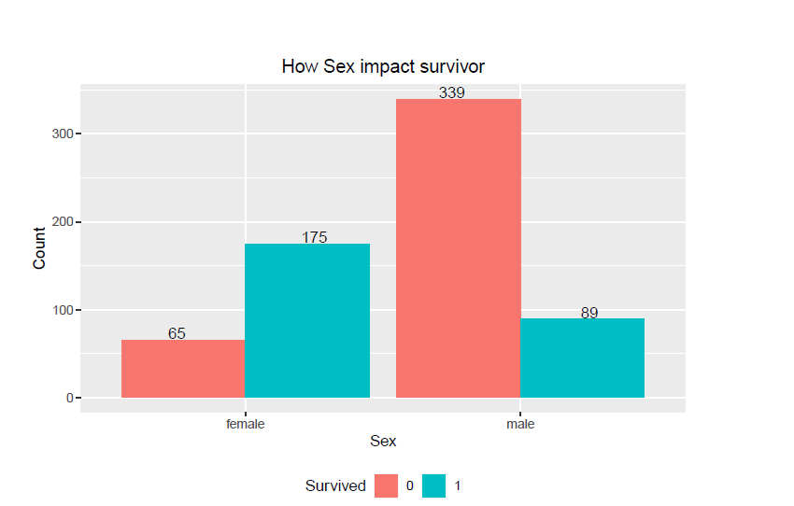
Sex
The mortality rate of men is significantly higher than that of women

Slide 14
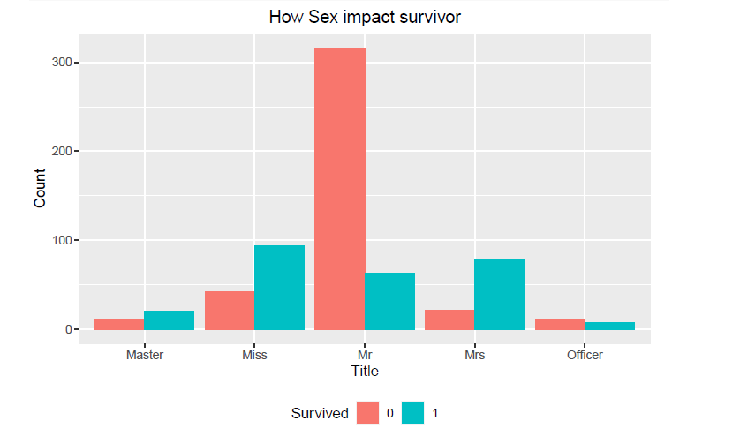
Title
From the classification of titles, we can still see that men have the lowest survival rate, while women have the highest survival rate. At the same time, the survival rate of those with higher status has not improved significantly.

Slide 15
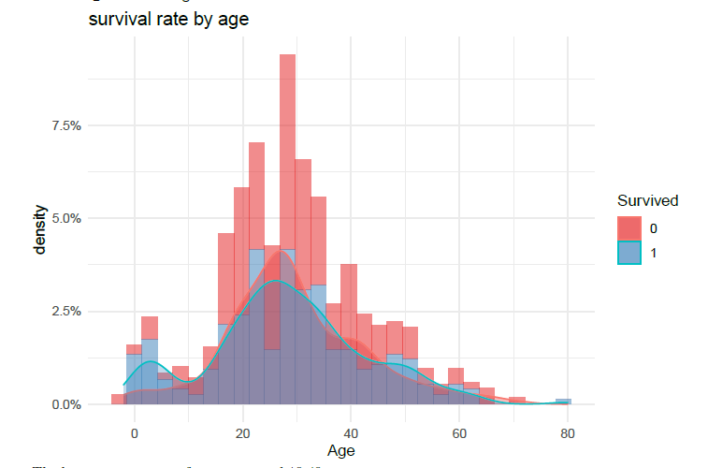
Age
The largest proportion of survivors aged 18-40.

Slide 16
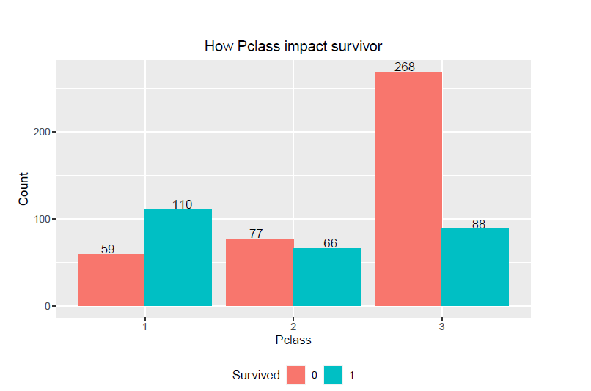
Pclass
As the cabin level is higher, the survival rate is higher.

Slide 17
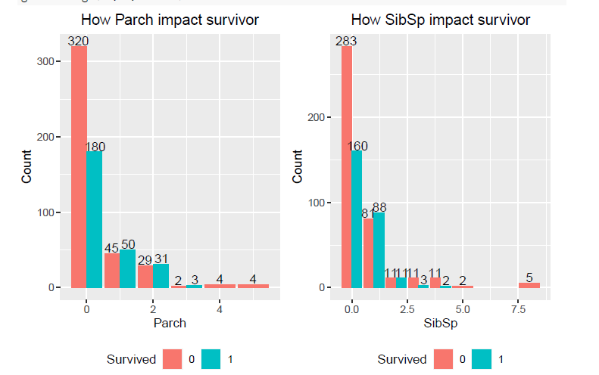
Parch & SibSp
The number of family members does not seem to have much to do with survival rates.

Slide 18
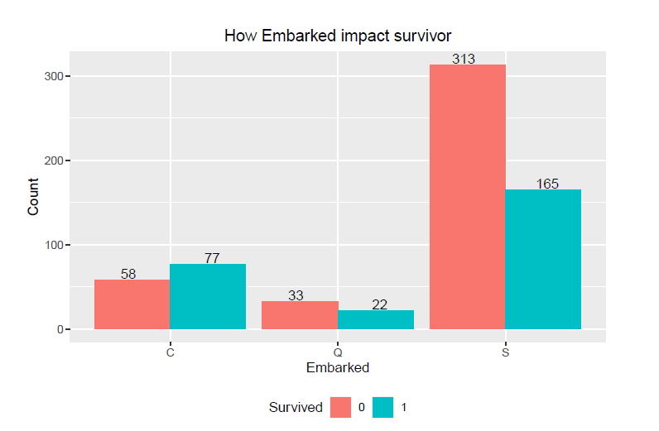
Embarked
This picture is very similar to the cabin level chart, Those who boarded from port "c" had the highest survival rate. And those who board the ship from port "s" have the lowest survival rate. .

Slide 19
5. Modeling prediction
a. Random forest
b. Logistic regression
c. Ridge regression
d. Decision tree

Slide 20
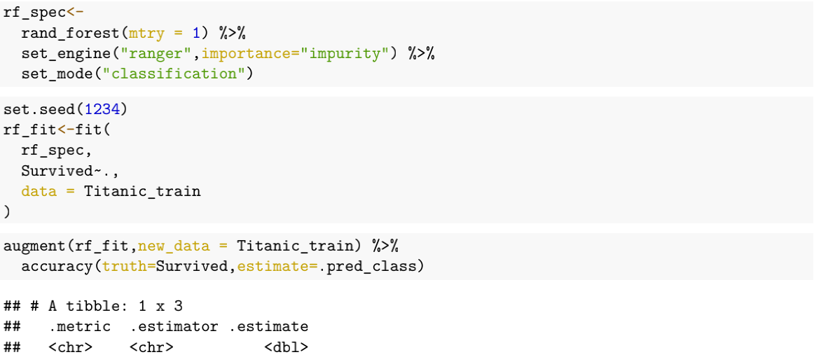
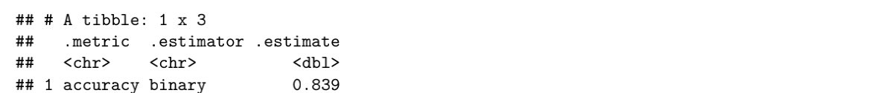
a. Random forest

Slide 21
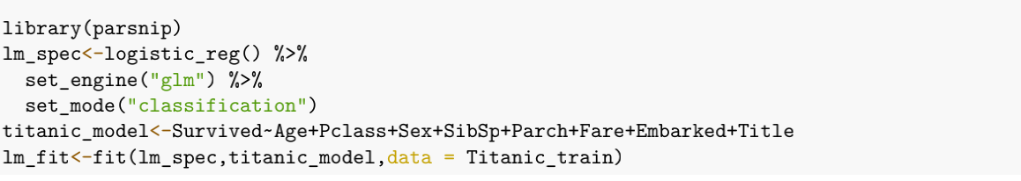
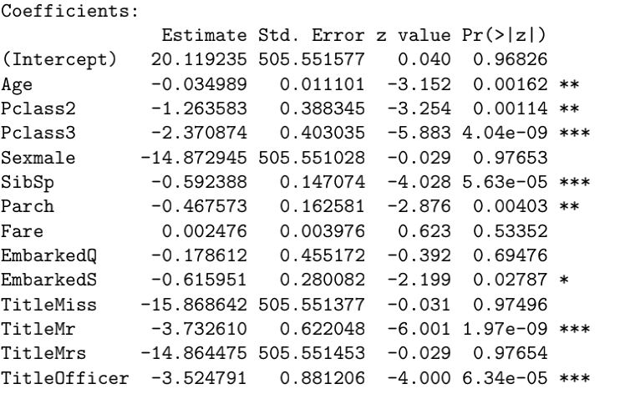
b. Logistic regression

Slide 22

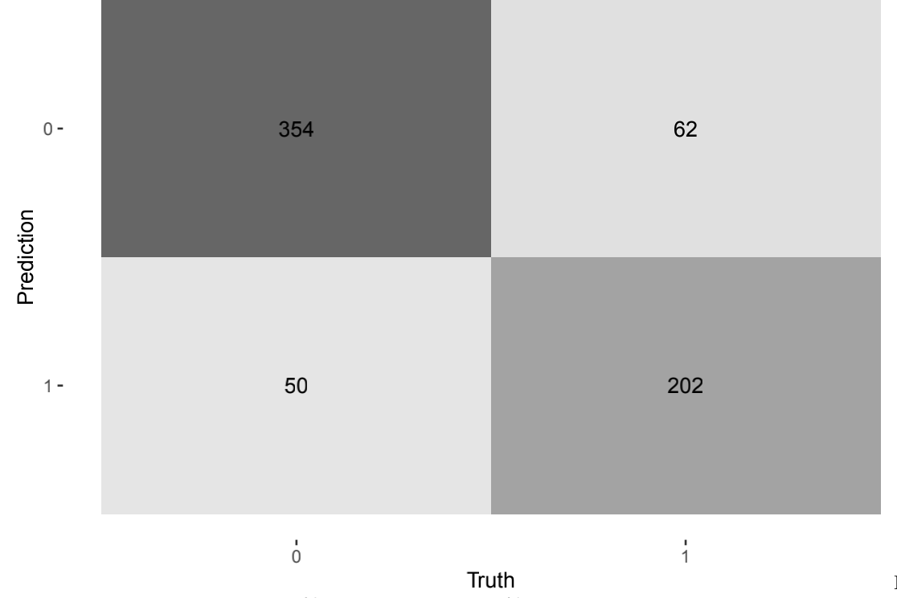
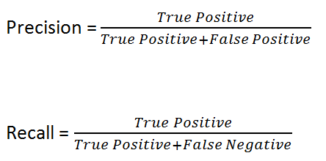
Titanic train data

Slide 23

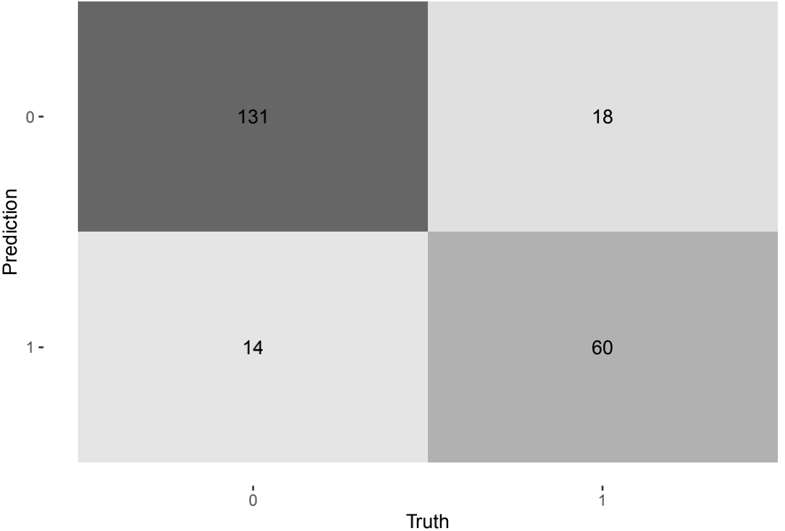
Titanic test data

Slide 24
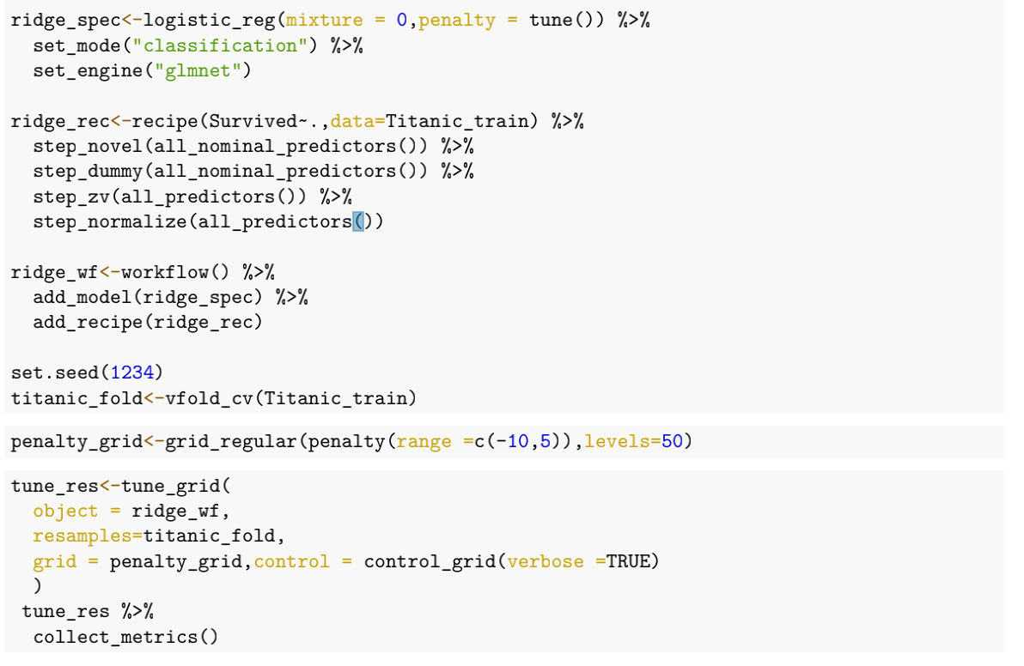
c.Ridge regression

Slide 25
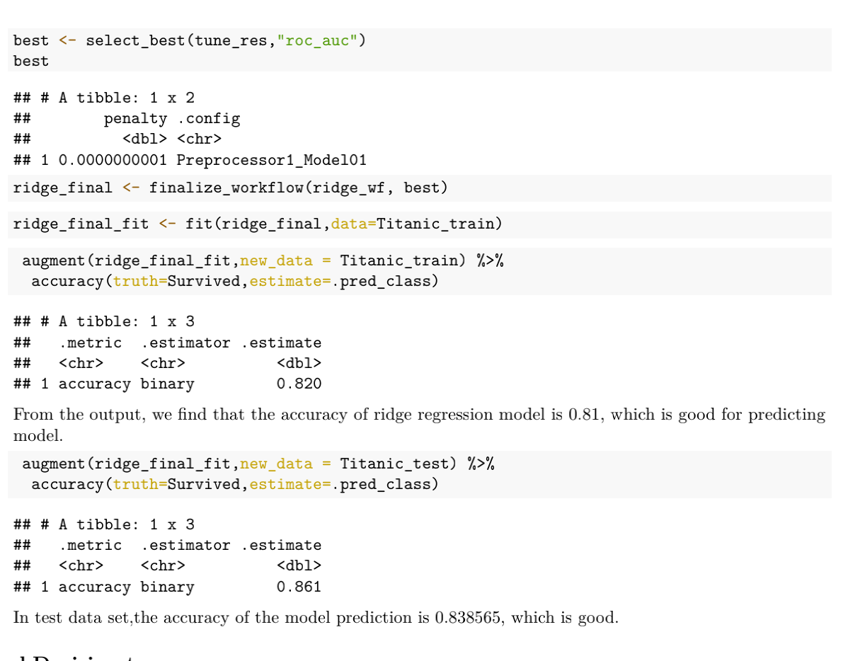

Slide 26
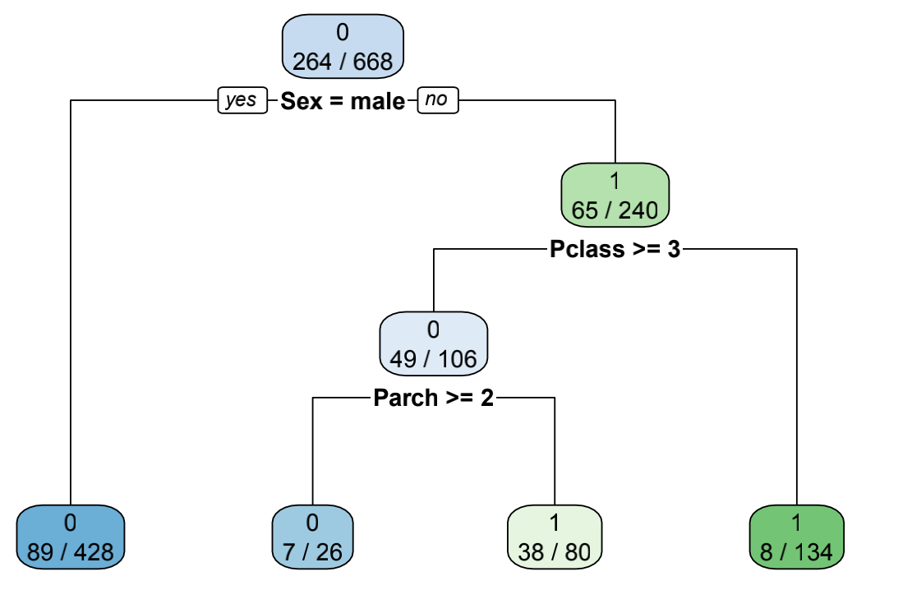
d. Decision tree

Slide 27
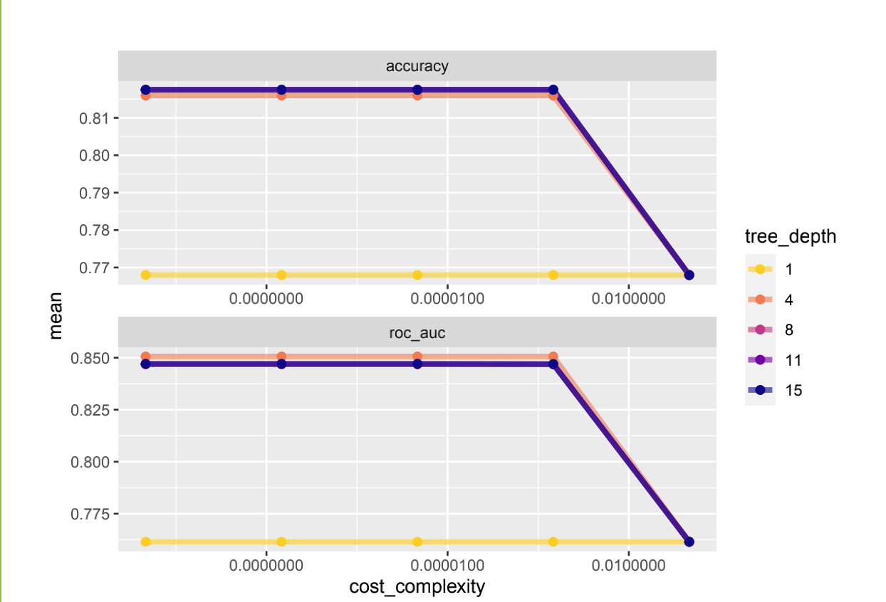
With the increase of depth:
The accuracy increase.
Intensify the generation of overfitting.

Slide 28
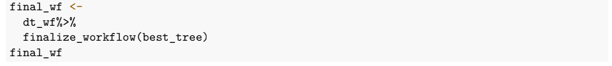
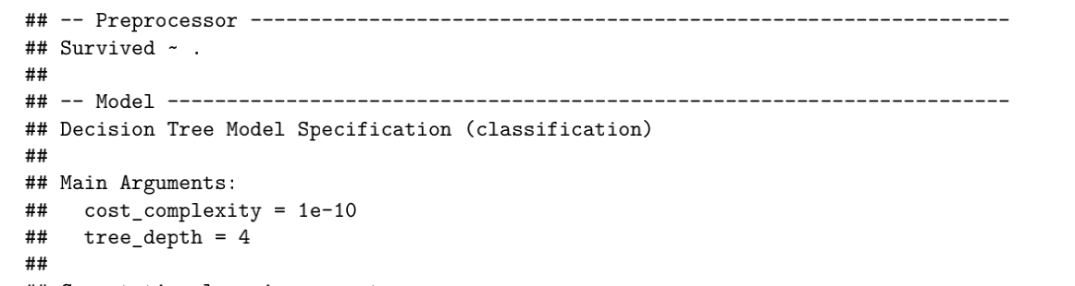

Slide 29
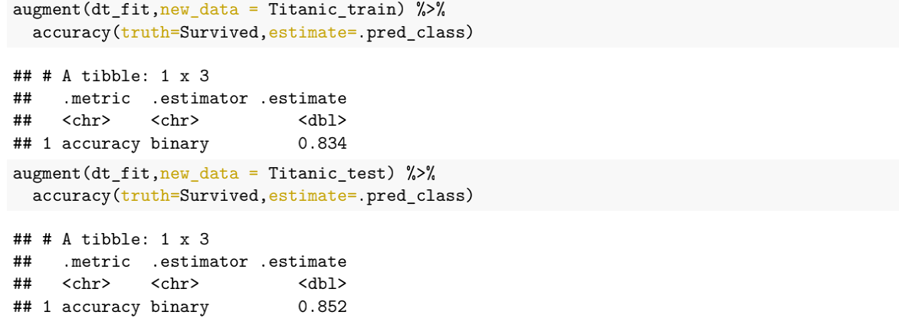

Slide 30
6. Conclusion
Variable “Sex” has the greatest impact on survival rate.
Young women who can pay higher fares are more likely to survive.
The model that works best is currently a random forest(0.86).The accuracy of logistic regression(0.83),ridge regression(0.82) and decision tree(0.83) in Titanic survival prediction model is almost the same and less than random forest.
For this case, we prefer to use random forest, because first , it can show which features are more important, the model generalization ability is strong, the training speed is fast, and the implementation is relatively simple. For unbalanced data sets, it can balance out errors. If a significant portion of the feature is missing, accuracy can still be maintained.

Slide 31
Thanks for listening!

